Slide 1

Capstone Project
Shrey Parekh
Notes:
Photos by Freepik

Slide 2
Peoples Sentiment affected by Vaccine Myths
A sentiment analysis performed to determine the feelings of people regarding vaccine.
Notes:
Photos by Freepik

Slide 3
Agenda
01
Background
06
Applying techniques
Context on the business objective
Topic modeling and sentiment Analysis
02
Business objective
07
Data Exploration
Describe the problem statement
Data
Visualizations
03
Data Pipeline
08
Results
Steps to perform Analysis
04
Data Preparation and Preprocessing
09
Summary
Cleaning the data, Imputation of the data
Conclusion, Limitation and
Next steps.

Slide 4

Data Science Pipeline
Data Acquisition
Topic Modelling and Sentiment Analysis
Results
Next Steps
1
2
3
4
5
6
7
Data Preparation and Preprocessing
Data Visualizations
Summary

Slide 5
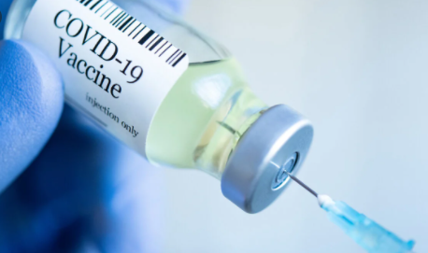

Background
Context
Vaccines are among the greatest public health achievements of modern times.
They have saved and continue to save millions of lives throughout the world.
Over the past few decade's vaccine hesitancy has emerged as a major health problem.
The reasons for vaccine refusal are complex and differ according to geographical and cultural context.
Notes:
This concern is fueled by misinformation and propagated through organized anti-vaccine groups.

Slide 6

Business Question
What are the sentiments of people? What is stopping them from taking vaccine?
Are their positive sentiments or negative sentiments towards hesitancy in taking vaccine?
Why Ask this Question?
This concern is fuelled by misinformation and propagated through organized anti-vaccine groups.
This is important because it gradually stops a country’s progress in getting everyone vaccinated.
Also arises concern if the vaccine is safe to take or not?
Notes:
Photos by Freepik

Slide 7
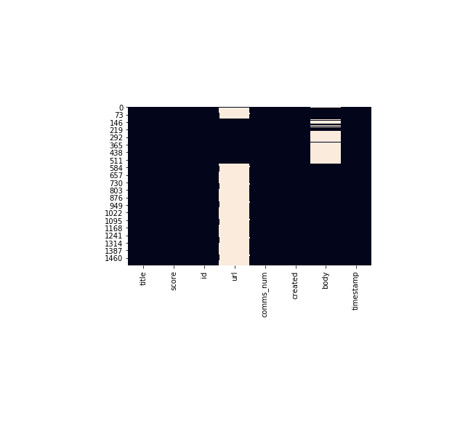

Data Set Sourced Kaggle Vaccine Reddit Myths
The heat map shows we can understand url is missing 69 percent of rows
Notes:
Photos by rawpixel.com / Freepik

Slide 8
Data Preparation and Preprocessing Topic Modelling
Steps taken for cleaning the raw data
Removing URL
Removing all irrelevant characters (Numbers and Punctuation)
Convert all characters to lowercase
Tokenization
Removing stop words
Stemming and lemmatization
Notes:
Photos by Evening_tao / Freepik

Slide 9
Data Preprocessed Title Example
Original | Preprocessed
Health Canada approves AstraZeneca | health, canada, approv, astrazeneca, covid,
COVID-19 in Canada: 'Vaccination passports' | covid, canada, vaccin, passport, near,
Coronavirus variants could fuel Canada's third | canadian, govern, extend, covid, emerg, benefit
Canadian government to extend COVID-19 | canada, pfizer, extrem, commit, meet, vaccin

Slide 10
Data Preparation and Preprocessing Sentiment Analysis
Steps taken for cleaning the raw data
Removing URL
Removing all irrelevant characters (Numbers and Punctuation)
Convert all characters to lowercase
Tokenization
Removing stop words
Stemming and lemmatization
Remove the words having < = 2
Convert the list of tokens back to the string
Notes:
Photos by Evening_tao / Freepik

Slide 11
Data Preprocessed Example
Title | Body | Text | Text Lemmatized
Comment | Your OP. It's not a myth. Only one vaccine con... | Your OP It s not a myth Only one vaccine | Your, OP, It, s, not, a, myth, Only, one,
Comment | I would too | I would too | I, would, too
Comment | You got it bud | You got it bud | You, got, it, bud
Comment | Zero links to autism and the charts argument | Zero links to autism and the charts argument | Zero, link, to, autism, and, the, chart
Clean Body
youropitsnotamythonlyonevaccinecontainsitandyo.
iwouldtoo
zerolinkstoautismandthechartsargument

Slide 12
Topic Modelling
LDA Approach
Applying Latent Dirichlet Allocation to our documents and classify them into topics. Latent Dirichlet Allocation (LDA) is an example of topic model and is used to classify text in a document to a particular topic. It builds a topic per document model and words per topic model, modelled as Dirichlet distributions.
Notes:
Photos by Evening_tao / Freepik

Slide 13
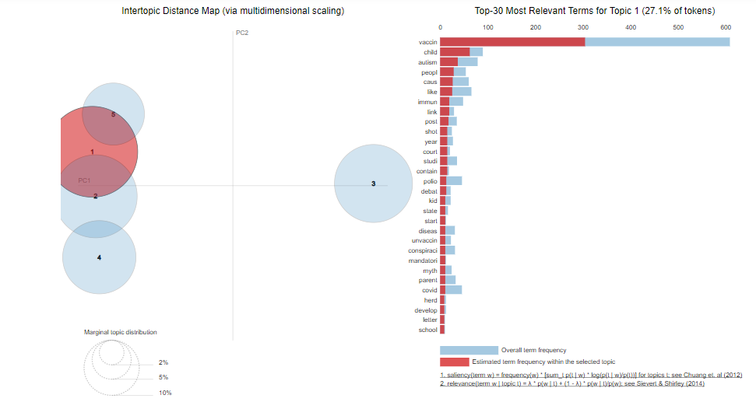
LDA Model before removing duplicates

Slide 14
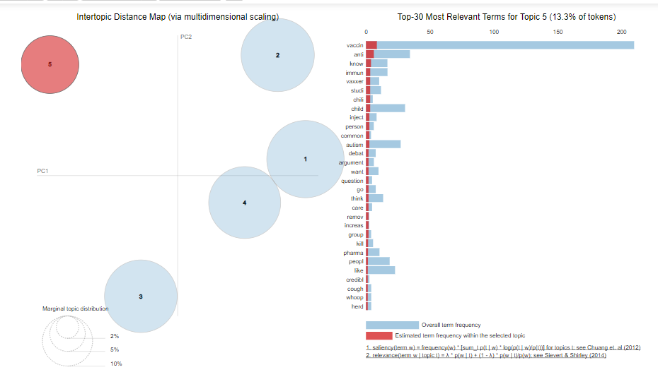
LDA Model after removing duplicates

Slide 15
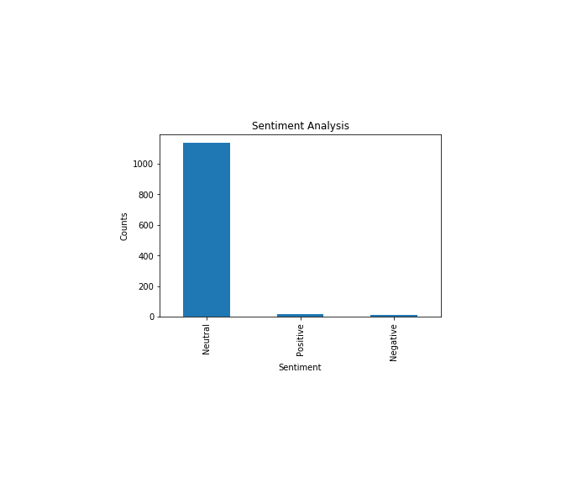
Sentiment Analysis Title

Slide 16
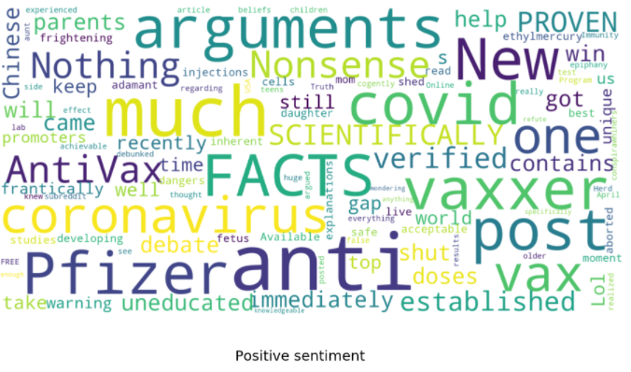
Data Visualizations Positive Sentiment

Slide 17
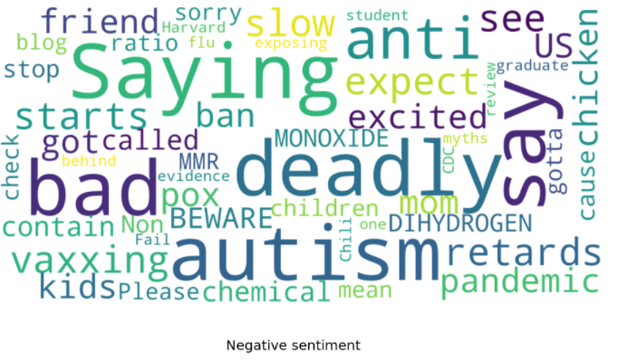
Data Visualizations Analysis Negative Sentiment

Slide 18
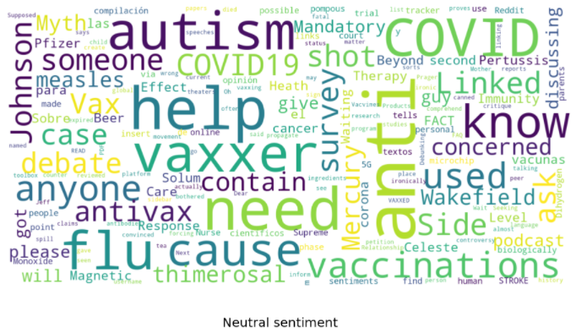
Data Visualizations Neutral Sentiment

Slide 19
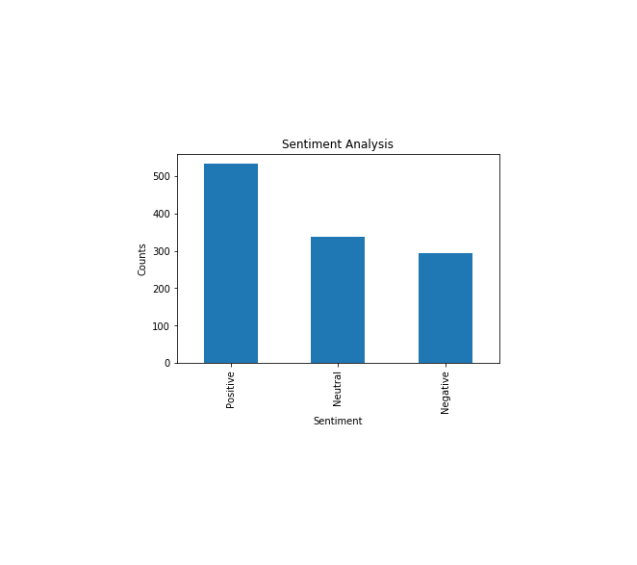
Sentiment Analysis Body

Slide 20
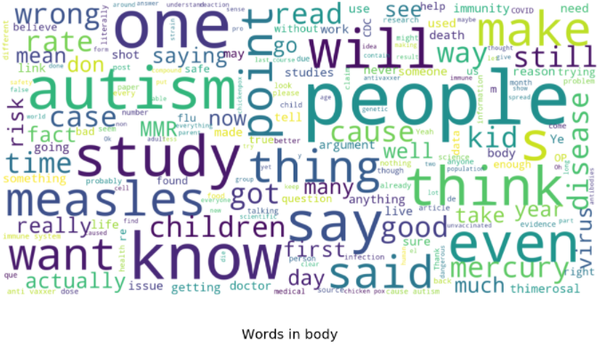
Positive Sentiment Visualization

Slide 21
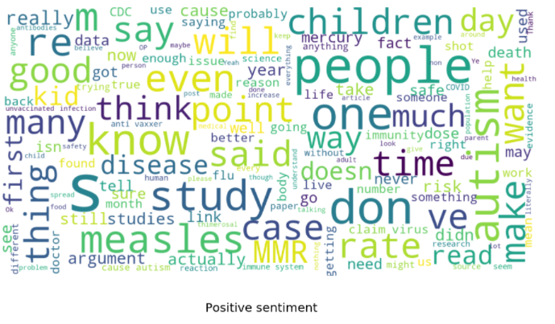
Positive Sentiment Visualization

Slide 22
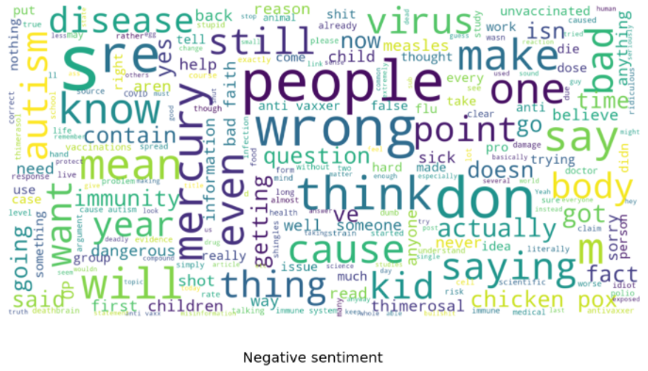
Negative Sentiment Visualization

Slide 23
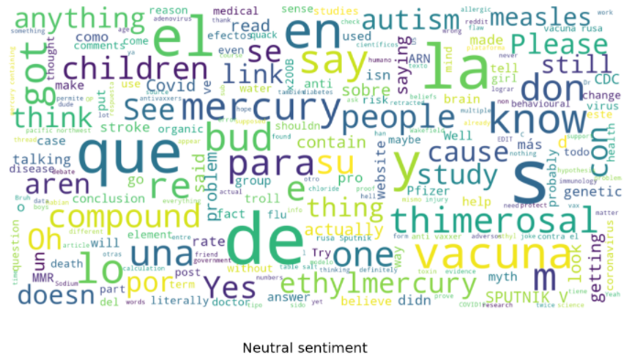
Neutral Sentiment Visualization

Slide 24
Results Sentiment Analysis
Insights
The insights we can derive from the word clouds from the title and body is that there is anger, fear, sadness in the dataset as well as positive emotions
There is hope that life will be back to normal as well as distrust over taking vaccine.
Reasons for vaccine hesitancy
Concerns for vaccine safety, adverse effects, toxicity, or poor quality of vaccine components
Doubts about technology used to produce vaccine
Notes:
Photos by Evening_tao / Freepik

Slide 25
Results Sentiment Analysis
Insights
Lack of information, information sources and influence of antivaccine proponents.
Concerns relating to COVID 19-vaccines
The novelty of the vaccines; mRNA- and adenovirus-based vaccines are relatively new types of vaccines, compared with most vaccines that are currently available.
Mistrust of vaccine benefit
Speed of vaccine development.
Notes:
Photos by Evening_tao / Freepik

Slide 26
Results Topic Modelling
 | Results after removing duplicates
Topic 0 | "vaccin" ,"autism" ,"child" ,"immun" ,"caus" ,"measl" ,"proof" ,"anti" ,"mercuri" "peopl"
Topic 1 | "vaccin" ,"like" ,"anti" "child" "measl" ,"studi" ,"post" ,"immun" ,"wakefield" "parent"
Topic 2 | "vaccin" ,"anti" ,"polio" ,"covid" "caus" ,"say" ,"child" ,"danger" ,"know“,"think"
Topic 3 | "vaccin" ,"autism“, "caus" ,"cancer" ,"public" ,"diseas" "child" ,"polio" ,"need“, talk"
Topic 4 | "vaccin" ,"anti" ,"know" ,"immun" "vaxxer" ,"studi" ,"chili" , "child" "inject" ,"person"'

Slide 27

Summary
We can conclude from our analysis that the sentiments of the people are with the vaccine. Due to their being a higher proportion of positive sentiments than neutral and then negative sentiments We can interpret that the people are concerned with their safety, children, parents' safety. They are also scared and angry due to the speed of vaccine development
From the results of topic modelling and sentiment analysis we can formulate that
There is negative sentiment due to distrust and misinformation about the vaccine also because of influence of anti vaccine proponents.
The Neutral sentiments show case people want to learn more information about the vaccine. They want more data to study, debate. In order to be sure to take
Vaccine.
Notes:
Photos by creativeart / Freepik

Slide 28
Summary
The limitations during this project was technical limitations in using word clouds
Effectively for sentiment analysis. Also, the cleaned data did not provide polarity and subjectivity to get the sentiment. So, I had to use the raw data, body, text with a few preprocessing methods
The next steps for this data set is that we can apply other techniques such as LSA model, Clustering Analysis on the data set. Also, in future we can use the sentiments as labels to create models for classification.
The recommendation is that in order to convert the negative sentiments into positive sentiments governments release more data regarding vaccine such as death toll of people taking vaccine. This will help in keeping transparency with the people and remove all the hesitancy people have towards vaccine. This will also increase the vaccination drive.
Notes:
Photos by creativeart / Freepik

Slide 29

THANK YOU
Notes:
Photos by Freepik

